Slide 1
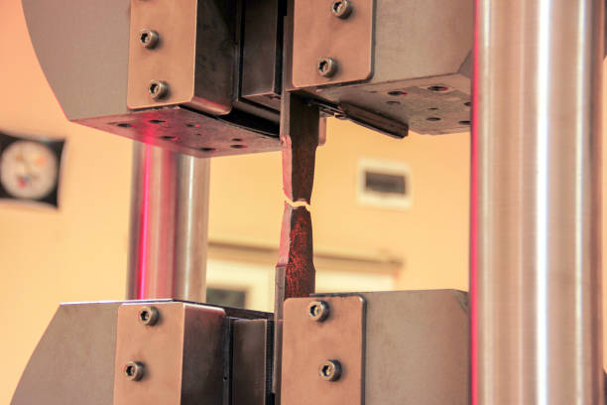

Ultimate Tensile Strength (UTS) Prediction of Austenitic steel using Machine Learning
Vaibhav Arvind Ghorpade
PGA-36 WD
LinkedIn GitHub

Slide 2

OVERVIEW
Introduction
- Objectives, Project goals
Data Understanding
- Data description, exploration, quality assessment
Data Preparation
- Data cleanup, preparation, formatting.
Modeling
- Building regression models
Evaluation and Tuning
- Model evaluation, Hyper Parameter Tuning
Best model - Justification and Conclusion
- Result analysis, conclusion, future work
Challenges Faced
Business Insights

Slide 3
1. INTRODUCTION
What is Tensile Strength of Steel ?
Importance of Tensile Strength of steel.
Conventional Processes to find out Tensile Strength Austenitic steel

Slide 4

Problem Understanding
The designers, manufacturers, researchers of material sciences and engineering have habitually contingent on results obtained from the experiments that are conducted in testing laboratory to identify the mechanical properties of any material
So, to obtain the desired properties for a material they need to customize composition of material and process parameters of the material prior of conducting the experiment
To meet the modern market requirements and to withstand the competitiveness many industries emphasized to produce high precision and good quality steel products

Slide 5
Objective
The main goal of this project is to diminish cost and reduce time mechanical properties prediction to help the manufacturers and designers of advanced material science and engineering.
Improve UTS prediction accuracy to minimize material testing costs and optimize product performance
Enhance decision-making by providing reliable UTS estimates during the design and manufacturing process
Accurate prediction of material mechanical properties and its behavior based on existing data has been the persistent effort of many material researchers.

Slide 6

2. DATA UNDERSTANDING
In this section:
Data Source: www.phase-trans.msm.cam.ac.uk
Austenitic Steel Data: Description
Data organization and Instances
Features
Data Quality Assessment
Missing Data

Slide 7
Features
There are a total of 31 features and 2180 instances in the dataset.
Input contains Chemical composition, Sectional size, Temperature, Process of Manufacture
Features | Descripition
Cr | Chromium wt%
Ni | Nickel wt%
Mo | Molybdenum wt%
Mn | Manganese wt%
Si | Silicon wt%
Nb | Niobium wt%
Ti | Titanium wt%
Zr | Zirconium wt%
Ta | Tantalum wt%
V | Vanadium wt%
Features | Descripition
W | Tungsten wt%
Cu | Copper wt%
N | Nitrogen wt%
C | Carbon wt%
B | Boron wt%
P | Phosphorus wt%
S | Sulphur wt%
Co | Cobalt wt%
Al | Aluminium wt%
Sn | Tin wt%
Features | Descripition
Pb | Lead wt%
Solution_treatment_temperature | In Kelvin(K)
Solution_treatment_time(s) | In Seconds
Water_Quenched_after_s.t. | Yes, No
Air_Quenched_after_s.t. | Yes, No
Grains mm-2 | Numeric
Type of melting | Categorical
Size of ingot | Categorical
Product form | Categorical
Temperature (K) | In Kelvin(K)
UTS (M Pa) Target Feature | Tensile Strength

Slide 8
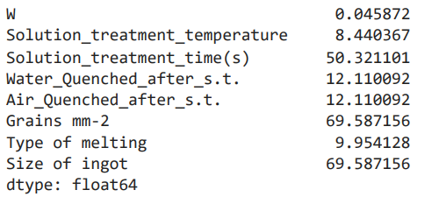
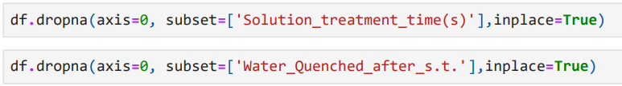
Data Wrangling
As presence of an Na indicates that the value was not reported in the dataset, so Na converted it into null values
Dealing With Missing Data columns having nulls more than 50% of instances
Columns such as Grains mm-2 , Size of ingot contains large missing values. So these columns has been dropped
2. Columns such as Product Form , Type of Melting does not play any ole for ultimate tensile strength. So These Columns also has been dropped
Columns such as Zr , TA , W , Sn , Pb contains all values as 0 . So these Columns also has been dropped
Solution_treatment_time(s) , Water_Quenched_after_s.t. , Air_Quenched_after_s.t. plays an Important Role as Properties of steel mainly depends on it. So records having Null value in these columns cannot be used.

Slide 9
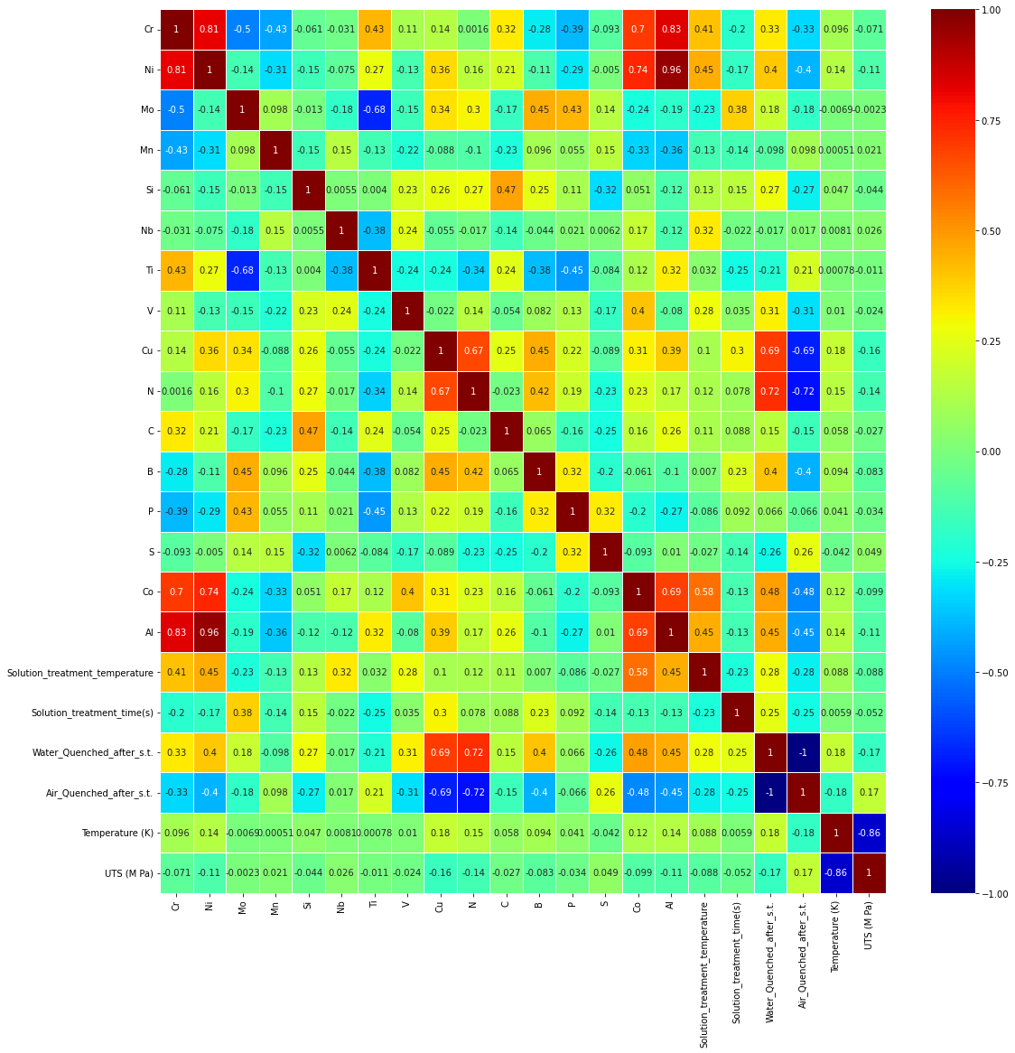
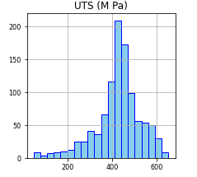
Exploratory Data Analysis
Fig. Co-relation Matrix
Fig. Histogram of Target Column

Slide 10
3. DATA PREPARATION
Dropping Column having correlation >0.75 or <0.75
Cr , Ni , Air_Quenched_after_s.t. as there is high correlation greater than 0.75 or less than -0.75
II. Manual Label Encoding
Replacing Categorical Values with numeric values for ordinal categories
Ultimate Tensile Strength (UTS) Prediction of Austenitic Steel using machine learning

Slide 11

4. MODELING
In this section:
Linear Regression
DecisionTree Regressor
RandomForest Regressor
KNeighbors Regressor
Support Vector Regressor
Bagging Regressor with DT Regressor
AdaBoostRegressor
Gradient Boosting Regressor
XGBRegressor
Ridge
Lasso
Ultimate Tensile Strength (UTS) Prediction of Austenitic Steel using machine learning

Slide 12
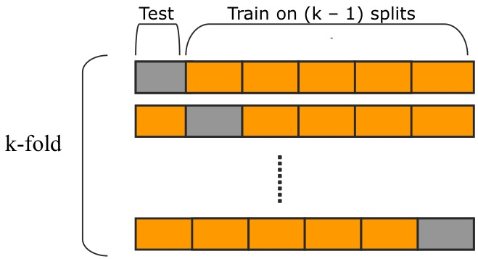
Modeling Pipeline
CSV File
(Raw Data)
Data Cleaned File
K-Fold Cross Validation Procedure
Label Encoding
Modeling with 11 models: (using K-Fold CV)
LR, DT, KNN, RF, ADABOOST, BAGGING, SVM,BAGGING WITH DT, ADABOOST,GRADIENT BOOST,XGB,RIDGE,LASSO
Results
11 Analysis
Hyper Parameter Tuning using GridSearchCV
Ultimate Tensile Strength (UTS) Prediction of Austenitic Steel using machine learning

Slide 13

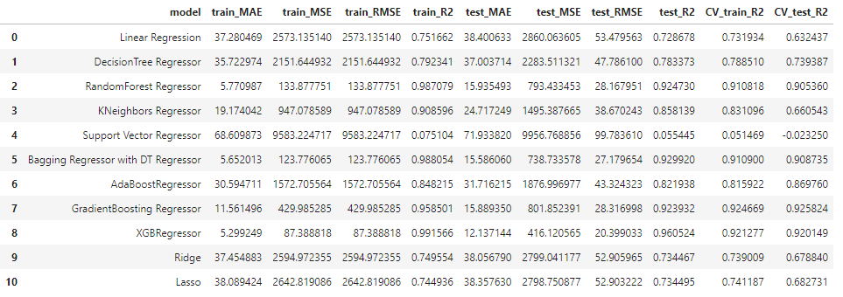
5. EVALUATION
Evaluation reporting of:
XGB Regressor:
Train_R2: 99.1556 test_R2: 96.05
From Above table, it is clear that XGB regressor giving better R square on both train and test data.
Ultimate Tensile Strength (UTS) Prediction of Austenitic Steel using machine learning

Slide 14
Hyper Parameter Tuning
Sr. No. | Model | Parameter Grid | GridSearchCV
 |  |  | Best Parameter | Accuracy
1. | XGBoost Regressor | base_score=[0.25,0.5,0.75,1] n_estimators = [100, 500, 900, 1100, 1500] max_depth = [2, 3, 5, 10, 15] booster=['gbtree','gblinear'] learning_rate=[0.05,0.1,0.15,0.20] min_child_weight=[1,2,3,4] | base_score=1 n_estimators=900 Max_depth=15 Booster=‘gbtree’ Learning_rate=0.1 Min_child_weight=1 | 95.49%
After tuning R2 score is decreasing, we will keep XGBRegressor model without tuning
Ultimate Tensile Strength (UTS) Prediction of Austenitic Steel using machine learning

Slide 15
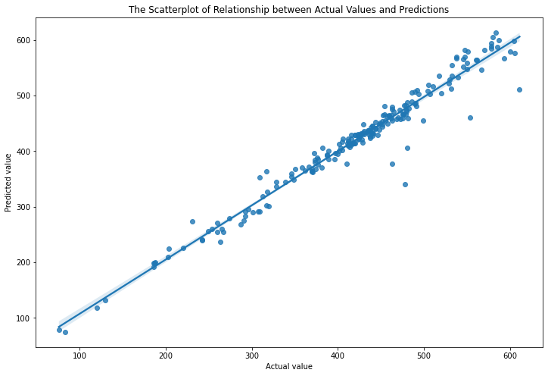
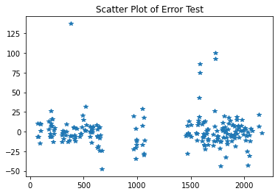
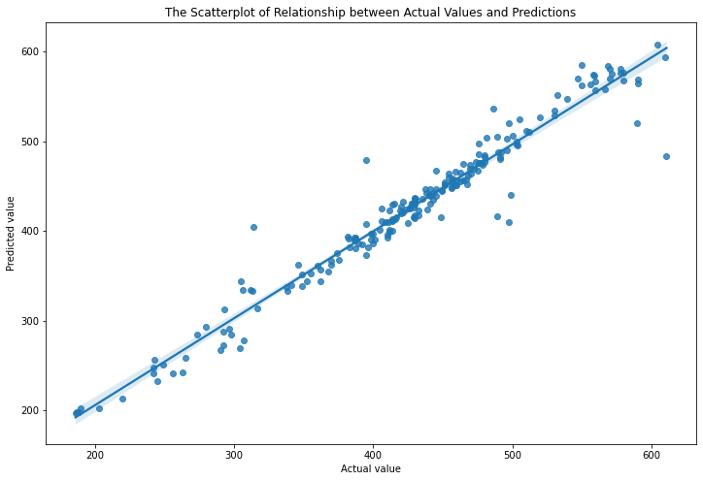
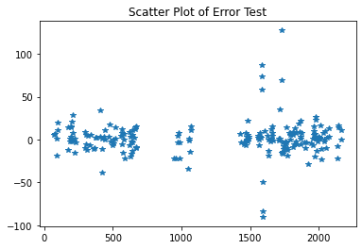
Model Accuracy with and without Outlier
With Outliers:
R2_test : 96.05
Without Outliers:
13 Outlier Removed
R2_test : 95.15
Ultimate Tensile Strength (UTS) Prediction of Austenitic Steel using machine learning

Slide 16
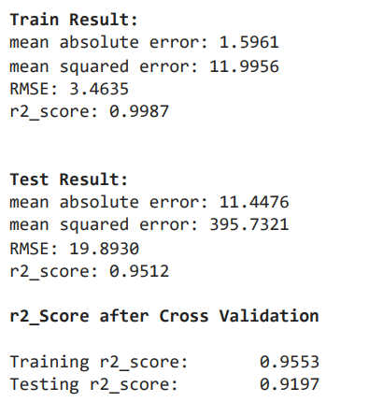
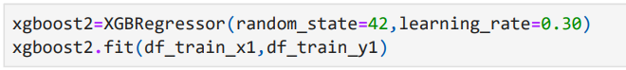
6. Result and Conclusion
After Successfully exploring data, cleaning, modelling using different supervised regressionalgorithm, it is clear that XGB classifier without tuning hyper parameter and after removing 13 outliers gives accuracy of 95.15% which is better as compared to other regression model used.
Ultimate Tensile Strength (UTS) Prediction of Austenitic Steel using machine learning

Slide 17
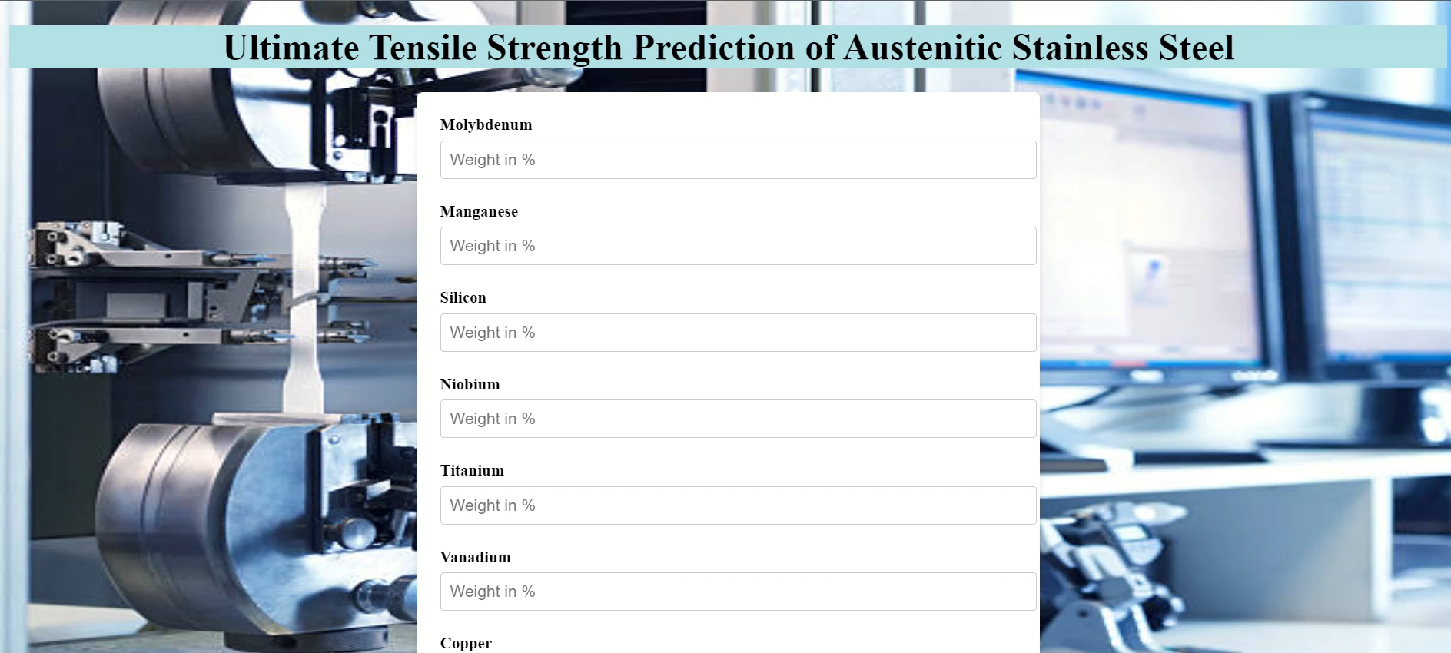
7. Model Deployment using AWS
Ultimate Tensile Strength (UTS) Prediction of Austenitic Steel using machine learning

Slide 18
8. Challenges Faced
Missing Values
Data Quality
Hyper Parameter Tuning
Ultimate Tensile Strength (UTS) Prediction of Austenitic Steel using machine learning

Slide 19

9. Business Insights
Current material sciences will definitely be affected by Data science and analytics by exaggerating accuracy and reliability in predicting mechanical properties using large ensemble of datasets from different material database
Proposed idea will be a breakthrough for conventional approach in terms of:
1. Diminish cost and reduce time
2. Improve UTS prediction
3. Enhance decision-making
Ultimate Tensile Strength (UTS) Prediction of Austenitic Steel using machine learning

Slide 20
Thank You
Ultimate Tensile Strength (UTS) Prediction of Austenitic Steel using machine learning

